Slide 1


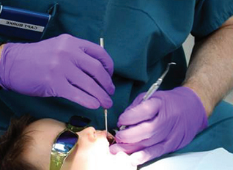




Topic 2
2
Specializations
New Words & Expressions
Writing
Get Ready
Speaking
Reading
Listening
Vocabulary

Slide 2
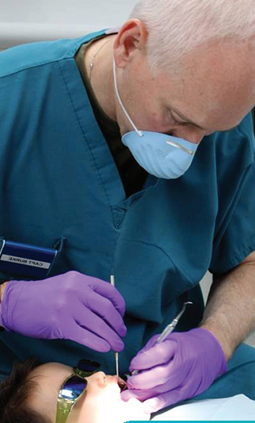

Topic 2
Get Ready
1
Before you read the passage, try to answer these questions.
1 What are some examples of specializations in dentistry?
2 What do patients do when dentists cannot meet their needs?

Slide 3

Topic 2
Specializations
Great Smiles
Dentists:
Drs. Allen Westhoven,
Mary Engle-Bart, Eunice Kim
Come get the care and attention you deserve!
① Our office is supplied with the most up-to-date equipment. Our dentists
have years of experience in general dentistry. They also offer expert
knowledge in various specialties:
② Braces are available for adults and children.
Root canals
Orthodontics:
Endodontics:

Slide 4
Topic 2
Specializations
Dentistry
课文参考译文
Topic 2 牙科的专业性
主页 关于我们 服务 联系方式
灿烂的微笑
牙医团队：
艾伦·韦斯特霍文医生、玛丽·恩格尔-巴特医生、尤妮斯·金姆医生
到我们的诊所来获取值得您拥有的照料和关怀！
我们的诊所配备有最新的设备。我们的牙医拥有多年的常规牙科经验，同时提供各种专业的专家知识。
口腔正畸：
提供适用于成人和儿童的牙套。
牙髓病：
提供根管治疗。

Slide 5
Topic 2
Specializations
Treatment for gingivitis and gum disease
Prosthetics for patients with maxillofacial injuries. Dentures and dental implants are available.
Care for infants, toddlers, and young children.
Wisdom tooth extractions
Oral / maxillofacial pathology and radiology services are unavailable.
③ Referrals are available for patients who require these services.
Periodontics:
Prosthodontics :
Pediatric dentistry :
Oral surgery :

Slide 6
Topic 2
Specializations
Dentistry
课文参考译文
牙周病：
提供牙龈炎和其他牙龈疾病的治疗。
口腔修复：
适用于患者上颌面部损伤的修复。提供烤瓷牙和种植牙。
儿童牙科：
提供婴儿、幼儿和幼童的牙齿保健。
口腔外科手术：
提供智齿拔除。
不提供口腔/颌面病理和放射治疗服务，可以为需要这些服务的病人提供转诊介绍。

Slide 7
Topic 2
Specializations
Dentistry
Language Points
Explanation of Difficult Sentences
1. Our office is supplied with the most up-to-date equipment.
我们的诊所配备有最新的设备。
supply with供给，提供 up-to-date 最近的，最新的
e.g.
Our hospital supply the patients with the considerate service.
我们医院给患者提供周到的服务。
The hospital is furnished with the up-to–date inspection equipment.
我们医院具备最新的检查设备。

Slide 8
Topic 2
Specializations
Dentistry
Language Points
Explanation of Difficult Sentences
2. Braces are available for adults and children.
提供适用于成人和儿童的牙套。
be available for对…有用，有效
e.g.
The mouth health care should be available for prevention and treatment of the dental caries.
口腔健康保健对龋齿的预防和治疗有效。
This medicine is available for the tooth ache.
这种药对牙疼有效。

Slide 9
Topic 2
Specializations
Dentistry
Language Points
Explanation of Difficult Sentences
3. Referrals are available for patients who require these services.
可以为需要这些服务的患者提供转诊介绍。
who为关系代词，可引导的定语从句，在从句中作主语，宾语或表语。
e.g.
The woman who you visited last week is my private doctor.
上周你拜访的那个女人是我的私人医生。
She is the dentist who we are looking for.
她就是我们要寻找的牙医。

Slide 10
Topic 2
Specializations
Dentistry
Language Points
important words
specialty n.
A specialty is a branch of medicine in which one specializes, or concentrates one’s efforts towards a particular field or practice. 专业，特长
e.g.
She considered dentist as a possible specialty drawn to it as a way of being of service.
她考虑把牙医作为专业，被它吸引的原因是它是一种服务于人的职业。
His specialty was researching the oral diseases.
他的特长是治疗口腔疾病。

Slide 11
Topic 2
Specializations
Dentistry
Language Points
important words
surgery n.
Surgery is a branch of medicine concerned with diseases, conditions, and injuries that are repaired using manual and instrumental techniques. 外科手术
e.g.
He will require surgery on his left hand.
他的左手需要做手术。
The patient has just recovered from oral maxillofacial surgery.
患者刚刚从口腔颌面外科手术中康复过来。

Slide 12
Topic 2
Specializations
Dentistry
Language Points
important words
referral n.
A referral is a recommendation or the act of sending or directing someone to a medical specialist of treatment, aid, or information.
（向专科医生的）转诊介绍
e.g.
The patient is willing to accept the referral.
患者乐意接受转诊介绍。
Only 40 percent of patients were seen within two weeks of referral.
被介绍的转诊患者中仅有40% 的人在两个星期内得到诊治。

Slide 13
Topic 2
Reading
2
Read the webpage. Then, choose the correct answers.
1 What is the purpose of the webpage?
A to discuss the process of making referrals
B to inform patients about the dentists’ services
C to offer biographical details about each dentist
D to provide information about dental specialties
2 Which service is NOT available at Great Smiles?
A oral pathology C endodontics
B oral surgery D orthodontics

Slide 14
Topic 2
Reading
2
Read the occupational guide excerpt. Then, choose the correct answers.
3 Why does Great Smiles offer referrals?
A Because they specialize in pediatric dentistry.
B Because some services are unavailable.
C Because they do not perform root canals.
D Because they do not have up-to-date equipment.

Slide 15
Topic 2
Vocabulary
3
Match the words or phrases (1-8) with the definitions (A-H).
1 ____ surgery 2 ____ radiology 3 ____ pathology
4 ____ endodontics 5 ____ periodontics 6 ____ orthodontics
7 ____ prosthodontics 8 ____ pediatric dentistry
F
G
H
D
A
B
E
C
A a branch of dentistry dealing with the health of gum tissue
B a branch of dentistry dealing with the irregularities and correction of teeth
C a branch of dentistry dealing with the care of infants, toddlers, and children
D a branch of dentistry dealing with dental pulp
E a branch of dentistry dealing with missing teeth or tissue
F a branch of dentistry that uses manual and instrumental techniques
G a branch of dentistry that interprets data and images for diagnoses
H a branch of dentistry concerned with recognizing and controlling diseases

Slide 16
Topic 2
Vocabulary
4
Write a word that is similar in meaning to the underlined part in each sentence.
1 Frank needed surgery for an upper jaw injury.
_ _ _ i _ _ o _ _ _ i _ _
2 All doctors need residency training in a particular medical field or practice.
_ _ e _ _ a _ _ y
3 Ellen asked her primary care physical for a(n) recommendation.
_ e _ e _ _ a _
m a x i l l o f a c i a l
s p e c i a l t y
r e f e r r a l

Slide 17
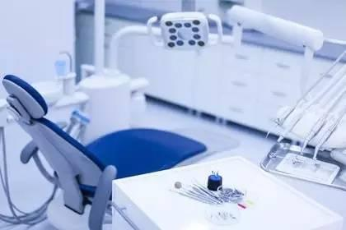
Topic 2
Listening
Listen and read the webpage again. Which patients require services in
prosthodontics?
5
Suggested answer:
Patients with maxillofacial injuries and people
with missing teeth require services in prosthodontics.

Slide 18

Topic 2
Listening
6
Listen to a conversation between a patient and a dentist. Mark the following statements as true (T) or false (F).
1 ____ The man does not specialize in pediatric dentistry.
2 ____ The woman’s daughter needs braces.
3 ____ The woman needs a referral to a specialist in prosthodontics.
T
F
F

Slide 19
Topic 2
Listening
6
Audioscript
Patient (F): I have a question about your specialties.
Dentist (M): Okay.
Patient: I have children, ages six and twelve. Do you offer services in pediatric dentistry?
Dentist: Yes. But, I don’t work with children. I specialize in endodontics.
Patient: Okay. Well, I think my twelve-year-old son needs braces.
Dentist: I’m afraid no one here works in orthodontics.
Patient: In your ad, I saw that you took care of dental irregularities.
Dentist: Yes, but in prosthodontics – dentures and implants. No worries, though. I can
make a referral.
Patient: I’d appreciate that. Thanks.

Slide 20
Topic 2
Listening
7
Listen again and fill in the blanks.
Patient: I have a question about your 1 ________________ .
Dentist: Okay.
Patient: I have children, ages six and twelve. Do you offer services in
2 ____________ ___________ ?
Dentist: Yes. But, I don’t work with children. I specialize in 3 ________________ .
Patient: Okay. Well, I think my twelve-year-old son, needs 4 _______________ .
Dentist: I’m afraid no one here works in 5 _______________ .
Patient: In your ad, I saw that you took care of dental irregularities.
Dentist: Yes, but in prosthodontics – dentures and implants. No worries, though. I can
make a 6 ____________ .
Patient: I’d appreciate that. Thanks.
specialties
pediatric dentistry
endodontics
braces
orthodontics
referral

Slide 21
Topic 2
Speaking
8
With a partner, act out the roles below based on Task 7. Then, switch roles.
USE LANGUAGE SUCH AS:
I have a question about ...
Do you offer services in ... ?
In your ad, I saw that ...
Student A: You are a patient. Talk to Student B about:
• dental specialties and services
• dental care for children
• information from an ad
Student B: You are a dentist. Talk to Student A about specializations and referrals.

Slide 22
Topic 2
Speaking
8
Suggested answer:
A: I have a question about your dental specialties. I have two children, ages three
and eleven. Do you offer services in pediatric dentistry?
B: Yes, but I specialize in endodontics.
A: Oh. Well, I think my eleven-year-old daughter, needs braces.
B: Actually, no one here works in orthodontics.
A: Really? In your ad, I saw that you took care of dental irregularities.
B: Yes, but in prosthodontics – dentures and implants. Don’t worry, though. I can
make a referral.
A: Okay. Thank you.

Slide 23
Topic 2
Writing
9
Use the conversation from Task 8 to fill out an email request form.
Name: _______________________________
Email address: ________________________
Service Requested: _______________________
Age(s) of patient(s): ______________________
Questions / Comments: ___________________ _______________________________________
_______________________________________
Request Form
Caitlin O’Brien
catty22@microfast.net
Pediatric dentistry
Three and eleven
My eleven-year-old daughter needs braces. Do you offer services in orthodontics?

Slide 24
Topic 2
New words & Expressions
specialty n. 专业，特长
orthodontics n. 口腔正畸学
endodontic n. 牙髓病学
periodontics n. 牙周病学
prosthodontics n. 口腔修复学
maxillofacial a. 上颌面的
surgery n. 外科手术
pathology n. 病理学
radiology n. 放射学
referral n. （向专科医生的）转诊介绍
pediatric dentistry 儿童牙科

